Slide 1
A variety of explicit/implicit time integrators for mass-spring system
g1n0st, Software Engineering, UESTC

Slide 2
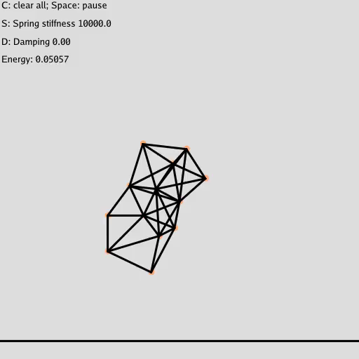
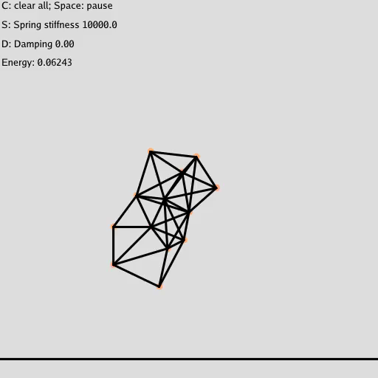


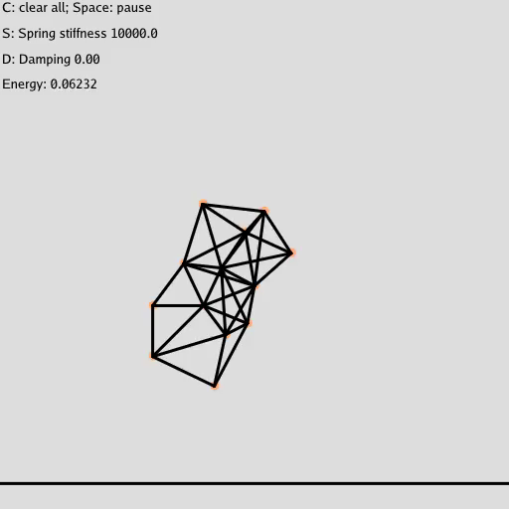
Explicit Euler
aver. Nan (ERROR OUTPUT)
Semi-implicit Euler
aver. 1.366ms
Midpoint Method
aver. 2.028ms
Runge-Kutta Method (RK4)
aver. 3.166ms
Jacobi-iter Method (10 iter/step)
aver. 13.726ms
Gauss-Seidel Method (10 iter/step)
aver. 18.899ms

